Slide 1


Overview and applications
of dimensionality reduction
Samuele Soraggi
Data Scientist
Bioinformatics Research Center,
Aarhus University

Slide 2
Overview and applications
of dimensionality reduction
Slides here
https://samuelesoraggi.github.io/Projection_and_clustering_tutorial/

Slide 3
Content/Objectives:
Recognize types of dim.red. methods
Master principles of how they work
Some examples and practical issues
Manifold learning: tSNE & UMAP
Computational improvements of tSNE
Conclusions
Break
Exercise illustration and setup
time

Slide 4
Dimensionality reduction
Mapping data from a space of dimension p to a space of dimension d<<p
dimensions
Dim 2
datapoints
p>>2 d=2
Dim 1

Slide 5
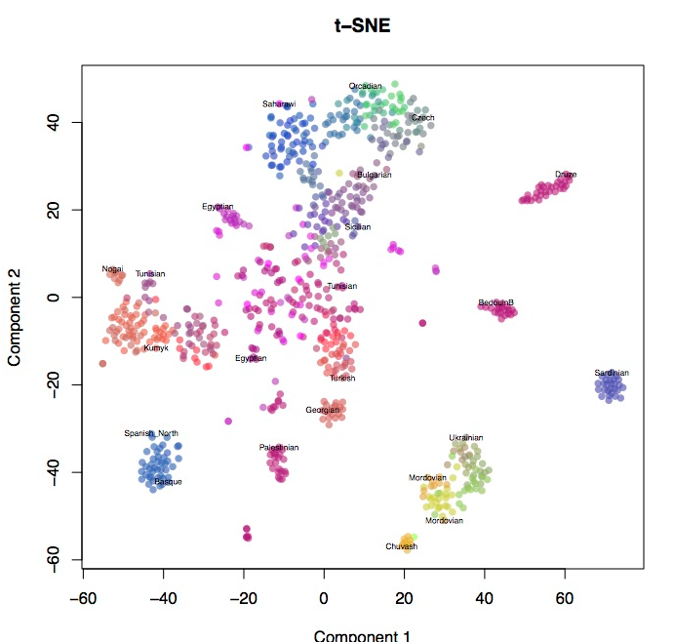
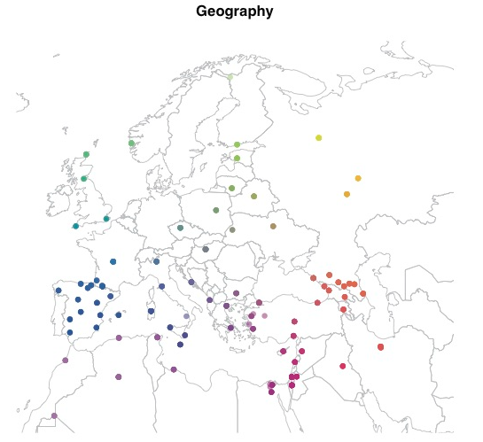
Dimensionality reduction: some applications
SNPs (columns) from individual genomes (rows) reflect geographical structure

Slide 6
Dimensionality reduction : some applications
SNPs (columns) from individual genomes (rows) reflect geographical structure

Slide 7
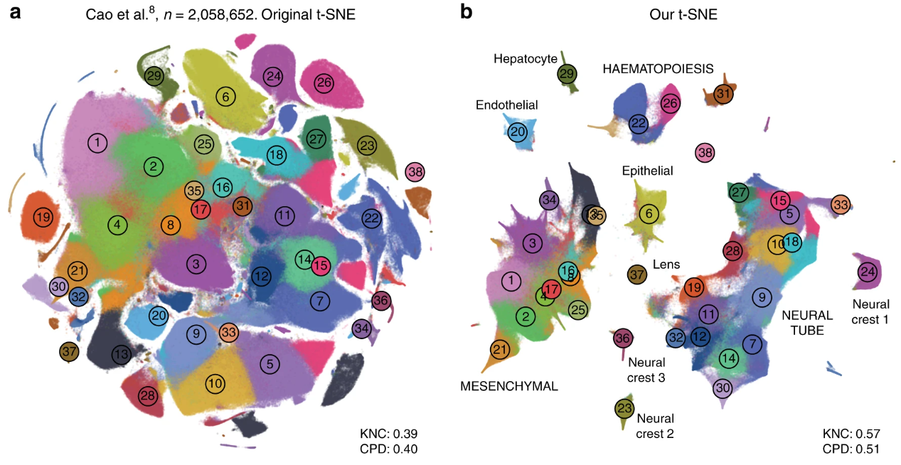
Dimensionality reduction: some applications
Transcriptomics: 1.3 Million cells (rows) and ~30_000 genes (columns)
Identification of cell types
Visualization of activated genes
Comparison between clusters

Slide 8
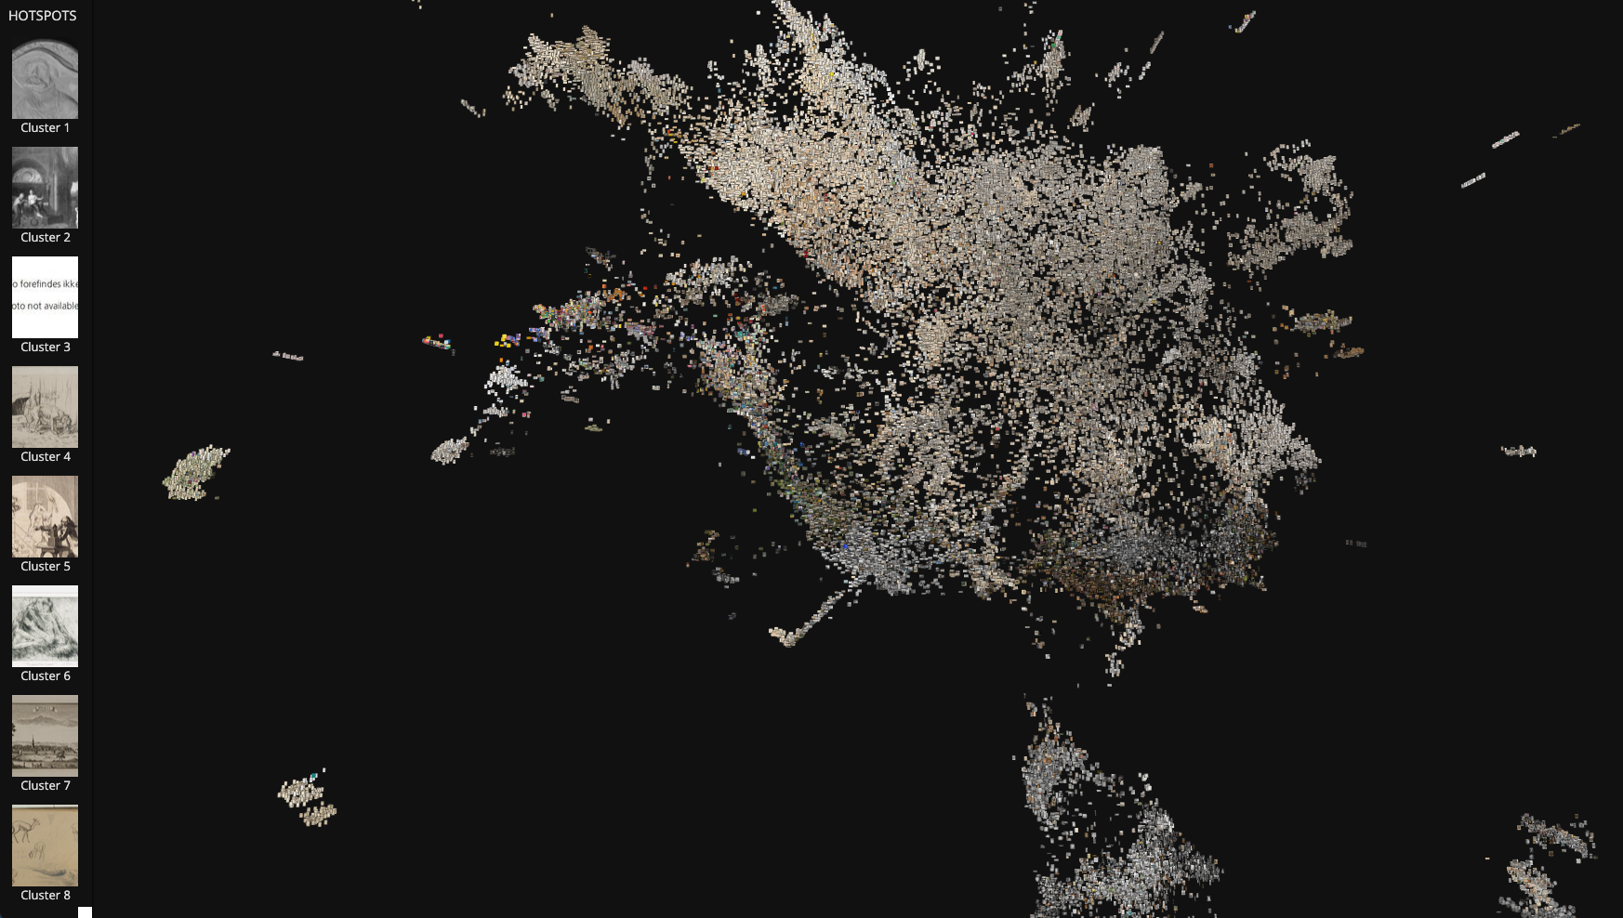
Dimensionality reduction
Art: categorizing and exploring large quantities of paintings

Slide 9
Dimensionality reduction: methods types
 | Linear (Parametric) | Non-linear | Non parametric
Unsupervised | PCA | kPCA ISOMAP | MDS tSNE UMAP
Supervised | LDA | kLDA

Slide 10
Dimensionality reduction: methods types
 | Linear (Parametric) | Non-linear | Non parametric
Unsupervised | PCA UMAP(only parametric) | kPCA ISOMAP | MDS tSNE UMAP
Supervised | LDA | kLDA | UMAP

Slide 11
 | L | Non-L
Unsup | PCA | kPCA
Sup | LDA | kLDA
Dimensionality reduction: PCA
p=2 → d=1
Based on
XX^{t} = U𝚺²U^{t}
Y = XU = U𝚺
minimizing reconstruction error
∥U𝚺 – U_{red}𝚺_{red}∥₂² or ∥X - X_{red}∥₂²

Slide 12
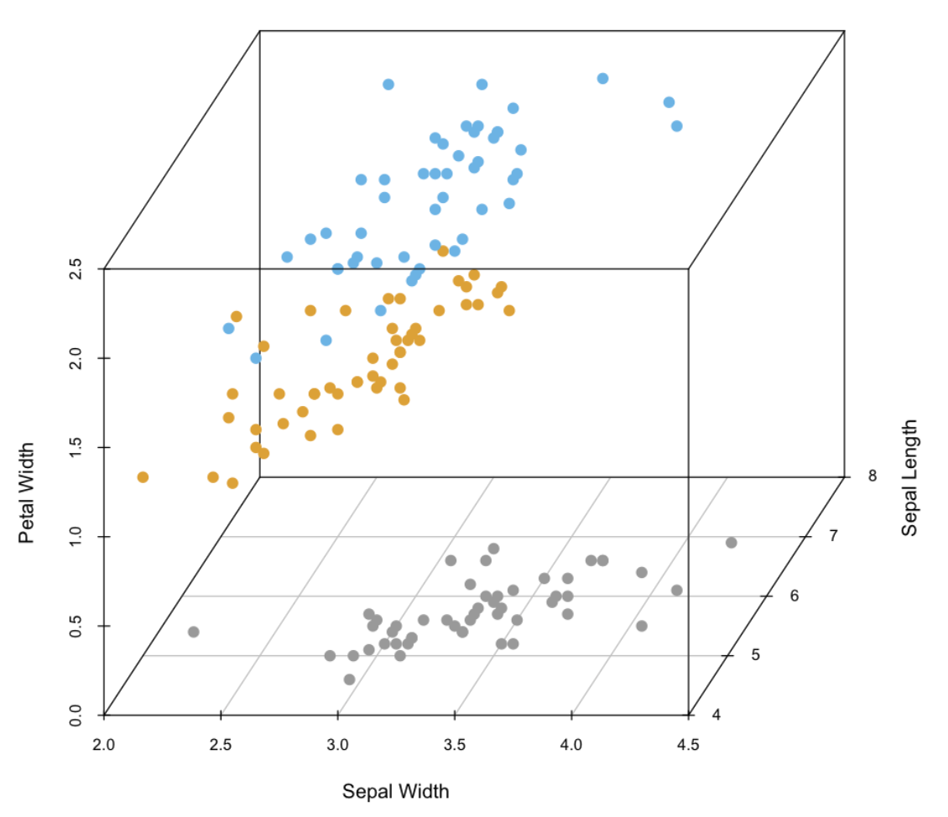
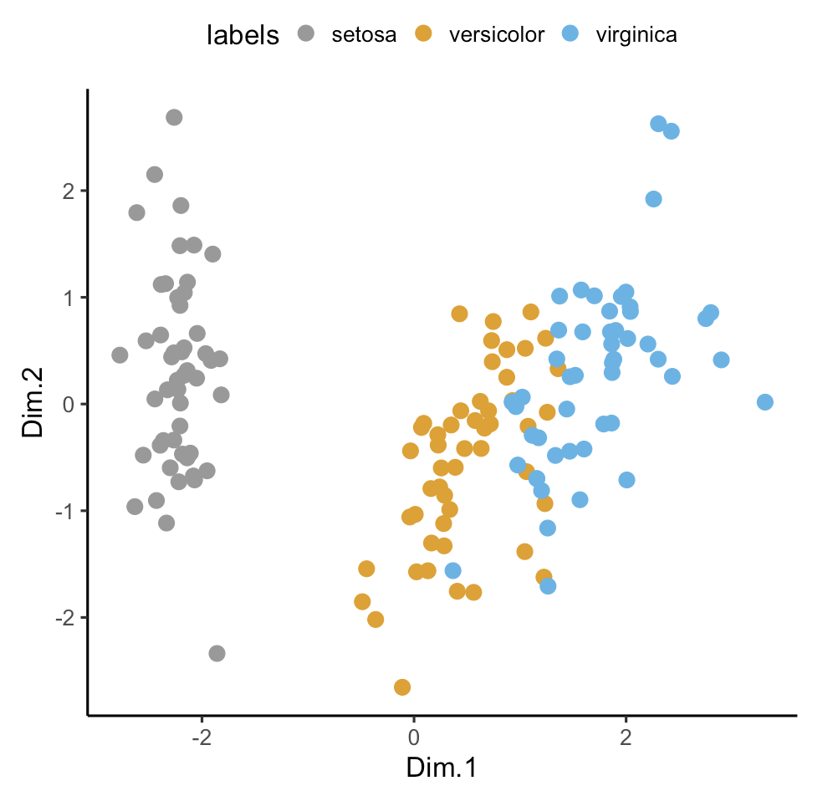
 | L | Non-L
Unsup | PCA | kPCA
Sup | LDA | kLDA
Dimensionality reduction: limits of linearity

Slide 13
 | L | Non-L
Unsup | PCA | kPCA
Sup | LDA | kLDA
Dimensionality reduction: kernelPCA
p=2 → p’→ d=1
𝜑

Slide 14
 | L | Non-L
Unsup | PCA | kPCA
Sup | LDA | kLDA
Dimensionality reduction: kernelPCA
p=2 → p’→ d=1
𝜑
𝜑( )

Slide 15
 | L | Non-L
Unsup | PCA | kPCA
Sup | LDA | kLDA
Dimensionality reduction: kernelPCA
Analogous to PCA
XX^{t} ⟷ 𝜑(X)𝜑(X)^{t} = [𝜑(x_{i})𝜑(x_{j})^{t} ]_{ij}
Y = U𝚺 ⟷ Y = Q 𝛬^{1/2}
by assuming centered kernel 𝜑 and a centered kernel matrix
M̃_{ij} = 𝜑(x_{i})𝜑(x_{j})^{t} = Q𝛬Q^{t}

Slide 16
 | L | Non-L
Unsup | PCA | kPCA
Sup | LDA | kLDA
Dimensionality re duction: kernel trick
p=2 → p’→ d=1
𝜑
[M]_{ij} = [ 𝜑(x_{i ,}x_{j}) ]
Avoids dot-products
Gaussian/RBF 𝜑(x_{i ,}x_{j}) = exp(-∥ x_{i}-x_{j}∥²/2𝞼²) 𝞼⩾0
Polynomial 𝜑(x_{i ,}x_{j}) = (x_{i}^{T}⋅ x_{j} + c)^{d} c⩾0,d⩾1
Linear 𝜑(x_{i ,}x_{j}) = x_{i}^{T}⋅ x_{j}
Laplacian 𝜑(x_{i ,}x_{j}) = exp(- 𝛂∥x_{i}-x_{j}∥) 𝛂⩾0
……..

Slide 17
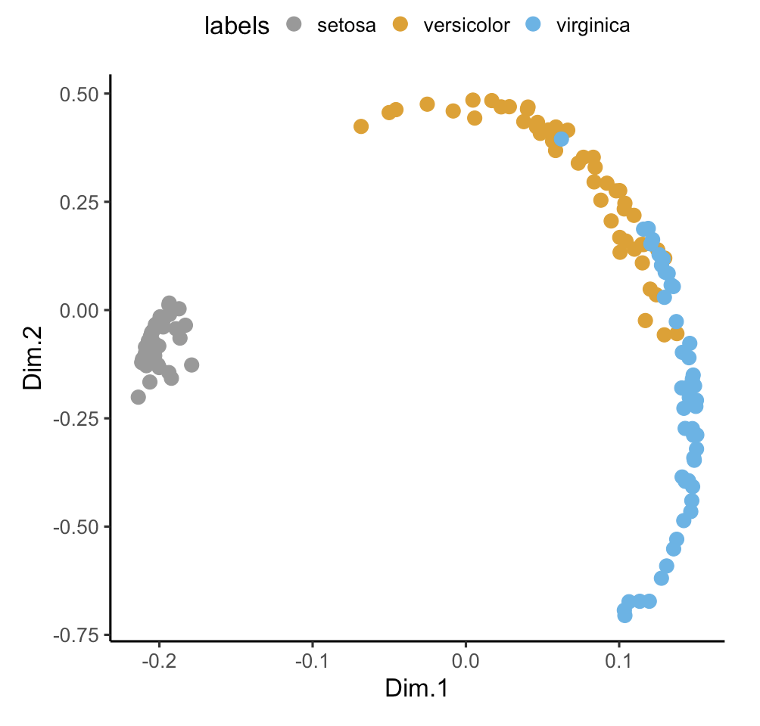
 | L | Non-L
Unsup | PCA | kPCA
Sup | LDA | kLDA
Dimensionality reduction: kernelPCA

Slide 18
 | L | Non-L
Unsup | PCA | kPCA
Sup | LDA | kLDA
Dimensionality reduction: LDA
p=2 → d=1
p=2 → d=1
Trade-off between distancing means and keeping low scatter (covariance) between points
(Unsupervised) PCA
(Supervised) LDA

Slide 19
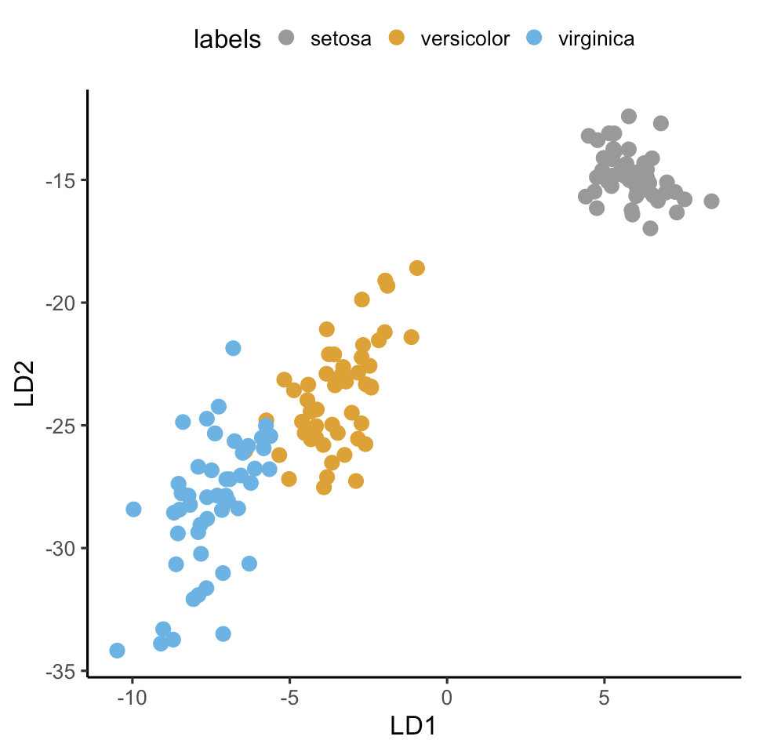
 | L | Non-L
Unsup | PCA | kPCA
Sup | LDA | kLDA
Dimensionality reduction: LDA

Slide 20
Dimensionality reduction:
Non-parametric methods → MDS
Distance-based cost function

Slide 21
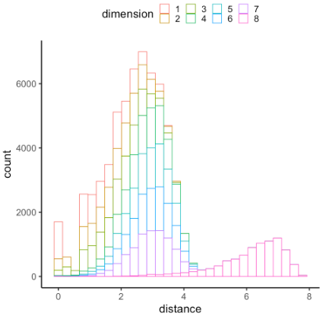
 | L | Non-L
Unsup | PCA | kPCA
Sup | LDA | kLDA
Dimensionality reduction:
Non-parametric methods → MDS
The cost function C = 𝚺_{i<j} [x_{ij} - ∥ y_{i} - y_{j}∥ ]² is optimized (wrt projections y) to preserve distances
Cost quadratic in nr. of data points
There are LARGER DISTANCES in high dimensions!

Slide 22
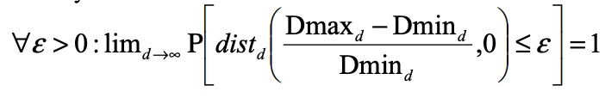
 | L | Non-L
Unsup | PCA | kPCA
Sup | LDA | kLDA
Dimensionality reduction:
Distances: curse of dimensionality
Distances increase in higher dimensions. Actually, The ratio of distance between nearest and farthest neighbour against the distance to nearest neighbor tends to zero with increasing dimensions

Slide 23
 | L | Non-L
Unsup | PCA | kPCA
Sup | LDA | kLDA
Dimensionality reduction:
Distances: curse of dimensionality
Distances increase in higher dimensions. Actually, So distances increase and we have no smaller distances to preserve

Slide 24
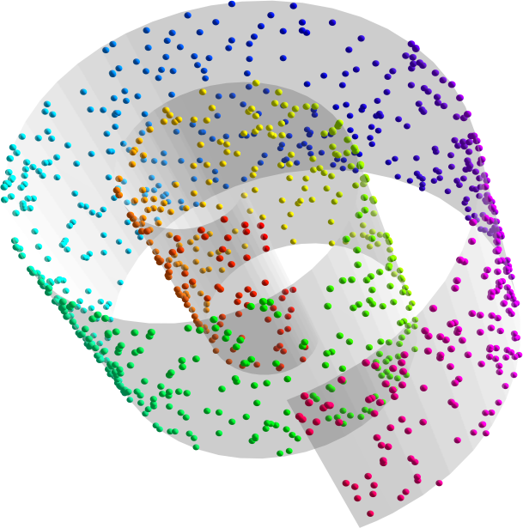
 | L | Non-L
Unsup | PCA | kPCA
Sup | LDA | kLDA
Dimensionality reduction:
Distance preserving → Manifold learning
Your data points are part of a geometric surface of dimension d
This surface is embedded in more dimensions p
Learn the structure and not the distances
Embedded in 3D through 𝝷 (Rotation angle)
p=3
d=2
Credit: mkbergman.com and bioinformatics-training.github.io

Slide 25
 | L | Non-L
Unsup | PCA | kPCA
Sup | LDA | kLDA
Dimensionality reduction:
Distance preserving → Manifold learning
All the iris flowers in the world (with the four measures as in the iris dataset) will not cover all ℝ⁴
Most points of ℝ⁴ are actually noise and not flowers
This set of points is part in a subspace of dimension d of ℝ⁴, d<4
The difference of two points will likely not give an existing flowers’ data (non-linear surface)
The surface has good geometric properties (locally flat, differentiable, …) making it a Riemannian manifold

Slide 26
Dimensionality reduction
Mapping data from a space of dimension D to a space of dimension d << D
Approaches can be categorized (mainly, but not limited to) as
Graph-based
Matrix Factorization
tSNE
PCA
NNMF
TRIMAP
UMAP
ISOMAP
CCA
DIFFUSION MAPS

Slide 27
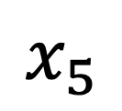
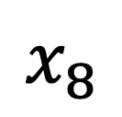
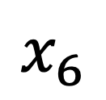
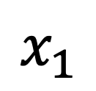
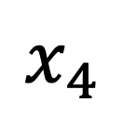
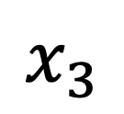
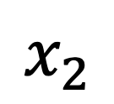
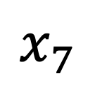
tSNE: Manifold description by graph
$$x_{3}$$
Datapoints as vertices of a graph
Pairwise edges are weighted by a distance function (local flatness)
Graph algorithms are well-known and implemented
$$x_{2}$$
$$x_{4}$$
$$x_{1}$$
$$x_{5}$$
$$x_{6}$$
$$x_{8}$$
$$x_{7}$$
Example: graph-exploration computational packages make it fast to find the
closest k elements of a data point $x_{1}$ (the k-nearest-neighbors of a point). In figure: k=7.

Slide 28
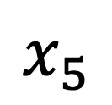
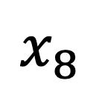
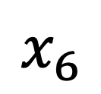
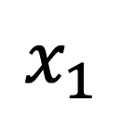
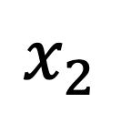
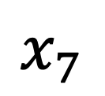
tSNE: Manifold description by graph
Build outgoing edges weighted by distance in the k-nearest neighborhood of each data point
Normalize them so they sum to one
$$x_{3}$$
$$x_{2}$$
$$x_{4}$$
$$x_{1}$$
$$x_{5}$$
$$x_{6}$$
$$x_{8}$$
$$x_{7}$$

Slide 29
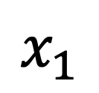
tSNE: Manifold description by graph
Build outgoing edges weighted by distance in the k-nearest neighborhood of each data point
Normalize them so they sum to one
$$x_{3}$$
$$x_{2}$$
$$x_{4}$$
$$x_{1}$$
$$x_{5}$$
$$x_{6}$$
$$x_{8}$$
$$x_{7}$$

Slide 30
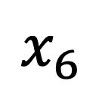
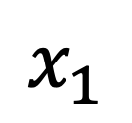
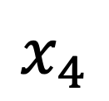
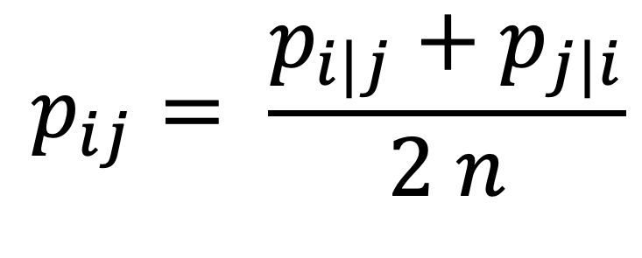
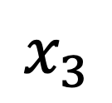
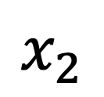
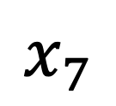
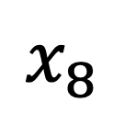
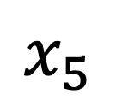
tSNE: Manifold description by graph
Average edges weight between each pair of nodes
normalize ALL edges of the graph so that their sum is 1
$$x_{3}$$
$$x_{2}$$
It corresponds to the formula
$$x_{4}$$
$$p_{ij}= \frac{p_{i|j}+p_{j|i}}{2 n}$$
$$x_{1}$$
$$x_{5}$$
$$x_{6}$$
$$x_{8}$$
A procedure of the same type is done
in the low-dimension (d << D) space
$$x_{7}$$

Slide 31
tSNE: Manifold description by graph
Average edges weight between each pair of nodes
normalize ALL edges of the graph so that their sum is 1
$$x_{3}$$
$$x_{2}$$
It corresponds to the formula
Mean of two normalized edges
Between i and j
$$x_{4}$$
$$p_{ij}= \frac{p_{i|j}+p_{j|i}}{2 n}$$
$$x_{1}$$
$$x_{5}$$
$$x_{6}$$
$$x_{8}$$
A procedure of the same type is done
in the low-dimension (d << p) space
$$x_{7}$$

Slide 32
tSNE: Manifold description by graph
Average edges weight between each pair of nodes
normalize ALL edges of the graph so that their sum is 1
$$x_{3}$$
$$x_{2}$$
It corresponds to the formula
Mean of two normalized edges
Between i and j
$$x_{4}$$
$$p_{ij}= \frac{p_{i|j}+p_{j|i}}{2 n}$$
$$x_{1}$$
$$x_{5}$$
$$x_{6}$$
$$x_{8}$$
Mean of all
edges
A procedure of the same type is done
in the low-dimension (d << p) space
$$x_{7}$$

Slide 33
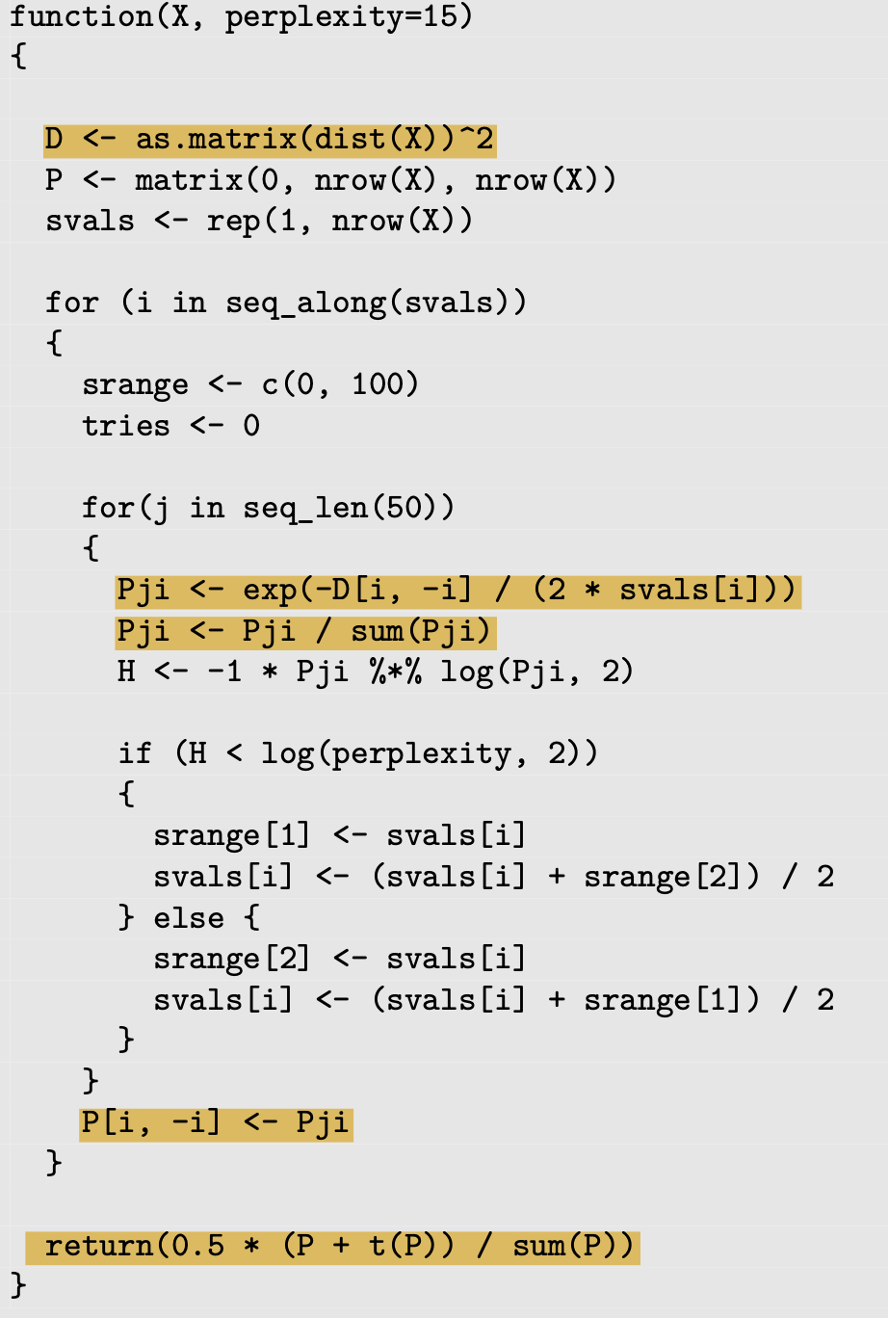
tSNE: high-dim graph implementation
In the book’s code (p.280) ALL
Distances are calculated and evaluated
in a gaussian kernel for each point i
D <- as.matrix(dist(X))^2
Pji <- exp(-D[i, -i] / (2 * svals[i]))
P_{ji}’s are normalized and assigned to the matrix P, so we have the ingoing and outgoing edges normalized separately
Pji <- Pji / sum(Pji)
P[i, -i] <- Pji
The final normalization is then
return(0.5 * (P + t(P)) / sum(P))

Slide 34
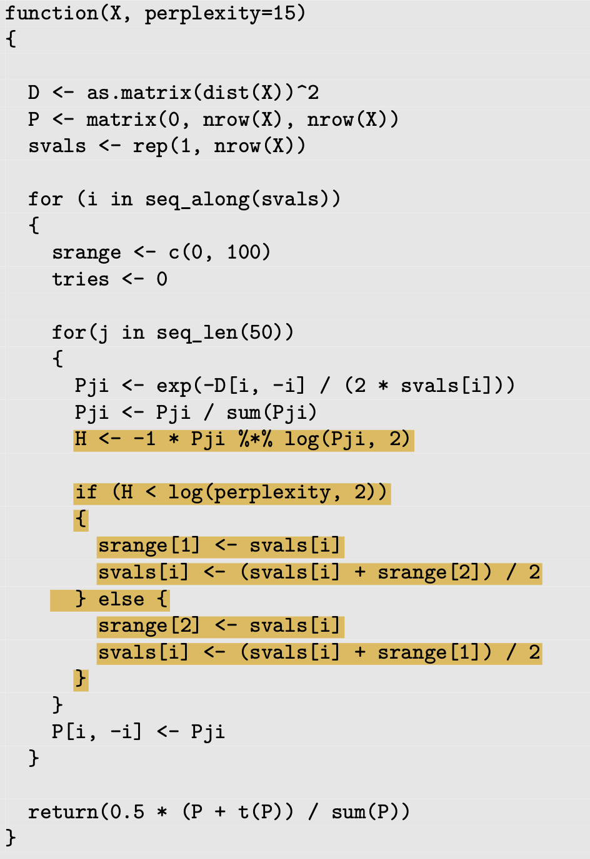
tSNE: high-dim graph implementation – Adaptive variance
Calculate entropy of i-th neighbors
H <- -1 * Pji %*% log(Pji, 2)
If H is less than the log-perplexity,
increase sigma, otherwise reduce it
if (H < log(perplexity, 2)){
……………. }

Slide 35
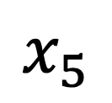
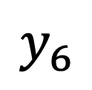
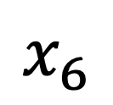
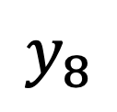
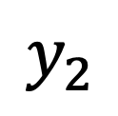
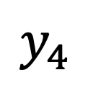
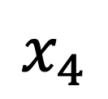
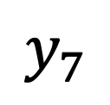
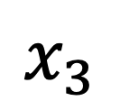
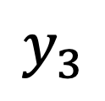
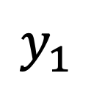
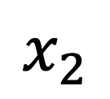
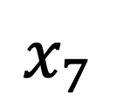

tSNE: optimization
In dimension D the edges are fixed
In dimension d<<D points must be arranged so that
the edges’ weights optimize a cost function
$$x_{3}$$
$$y_{5}$$
$$x_{2}$$
$$y_{6}$$
$$y_{3}$$
$$x_{1}$$
$$x_{4}$$
$$y_{8}$$
$$y_{1}$$
$$y_{4}$$
$$x_{5}$$
$$x_{6}$$
$$x_{8}$$
$$y_{7}$$
$$y_{2}$$
$$x_{7}$$
T-student’s distances
Gaussian distances with adaptive bandwidth

Slide 36















tSNE: optimization
In dimension D the edges are fixed
In dimension d<<D points must be arranged so that
the edges’ weights optimize a cost function
$$x_{3}$$
$$y_{5}$$
$$x_{2}$$
$$y_{6}$$
$$y_{3}$$
$$x_{1}$$
$$x_{4}$$
$$y_{8}$$
$$y_{1}$$
$$y_{4}$$
$$x_{5}$$
$$x_{6}$$
$$x_{8}$$
$$y_{7}$$
$$y_{2}$$
$$x_{7}$$
T-student’s distances (degree 1) – heavy tails
Gauss distances w/ adaptive bandwidth – light tails

Slide 37

Graph-based approaches: tSNE
Cost function (KL divergence)
The p’s are all fixed (D-dimensional space)
To make C small (ideally zero), you want q’s similar to p´s
You could do it by having all points in the same position
You cannot do it because you normalized the edges!
You mostly care about how points are distributed locally

Slide 38

tSNE: optimization
Cost function (KL divergence)
$$C=KL\left(P | Q\right)= \sum_{ij}{p_{ij}\log\left(\frac{p_{ij}}{q_{ij}}\right)}$$
The p’s are all fixed (D-dimensional space)
To make C small (ideally zero), you want q’s similar to p´s
Normalization helps avoiding clusters of packed points
tSNE mostly cares about how points are distributed locally even though it uses a t-student distribution

Slide 39

tSNE: optimization
Optimization done with gradient descent.
The gradient is w.r.t. the low-dimensional variables, then
It is a vector of length d with each component being
$$\frac{∂C}{{∂y}_{i}}=4 \sum_{j≠i}{\left(p_{ij}−q_{ij}\right){\left(1+{\left\|y_{i}−y_{j}\right\|}_{2}^{2}\right)}^{−1}\left[y_{i}−y_{j}\right]}$$

Slide 40




tSNE: optimization
Why?
$\frac{∂C}{{∂y}_{i}}$= $\frac{∂C}{{∂d}_{ij}}\frac{∂d_{ij}}{{∂y}_{i}}$
With $d_{ij}={\left\|y_{i}−y_{j}\right\|}_{2}^{2}$
helps in doing the derivatives. Look here.
The gradient of C is
$$\frac{∂C}{{∂y}_{i}}=4 \sum_{j≠i}{\left(p_{ij}−q_{ij}\right){\left(1+{\left\|y_{i}−y_{j}\right\|}_{2}^{2}\right)}^{−1}\left[y_{i}−y_{j}\right]}$$
Or also, multiplying both sides by q_{ij} :

Slide 41
tSNE: optimization
Optimization done with gradient descent. The gradient
of C is
Attractive forces P: keep
close points together
Repulsive forces Q: push points away from each other

Slide 42


tSNE: optimization
Calculate pairwise distances Q_{ij} with t-distribution
Normalize distances
Calculate the first part of the cost function’s gradient
Multiply by the difference (y_{i}-y_{j}). This is done all at once with the matrix Y and by casting the dimensions
Apply gradient descent and zero-center the data

Slide 43
tSNE: optimization
Effective makes good projections on non-linear manifolds
It makes sense in the way it is formulated
The locality of tSNE can be tuned (perplexity parameters)
Exponential cost in the number d of tSNE dimensions
Does not work “online”: if you get a new data point, you have to redo
ALL the calculations
Labels informative of data points cannot be used
Those issues are solved by another graph-based technique called UMAP

Slide 44

UMAP: Method in brief
It improves tSNE by use of topology theory
Topological construction leads to a cost function with different attractive/repulsive forces
Key to this is to use distances rendering the points uniform on the manifold

Slide 45

UMAP : Method in brief
It improves tSNE by use of topology theory
Topological construction leads to a cost function with different attractive/repulsive forces
Key to this is to use distances rendering the points uniform on the manifold
The manifold is approximated by an open cover of simplicial complexes

Slide 46

UMAP : Flavours
Standard umap (both python and R) is unsupervised non-parametric
It can be used to project labelled data, and to assign a test dataset to each class afterwards (supervised non-parametric)
An update optimizes the cost function with a neural network and the NN weights are used as a parametric function to assign test data (supervised parametric)

Slide 47

UMAP : Iris data

Slide 48
tSNE and UMAP: more resources
UMAP for tSNE: webpage of the author of the R uwot package, with deep and detailed explanations about how tSNE and UMAP work. Worth reading.
A page for the python package openTSNE: Here they explain some other improvements for tSNE, like interpolation and Barnes-Hut approximation.
Barnes-Hut approximation. How does the Barnes-Hut approximation work? Here you find the explanation and a clear animation you can tune to see the results of the algorithm.
Misread tSNE. Some simple interactive use cases to see how parameters of tSNE change an output.
Nice theoretical paper on tSNE.

Slide 49
Break – Questions
And
Exercise

Slide 50


tSNE: projection improvements - early exaggeration
Solves the crowding problem (points in general very close with the risk of breaking clusters of similar points)
How: In the factor 4(P - Q) of the gradient, multiply P by a factor (e.g. 12), and in the gradient descent divide the learning rate by the same factor. Go back to normal after a few iterations.

Slide 51
tSNE: projection improvements – momentum
Local optima of the gradient descent can create poor solutions. We can add a term to the descent to avoid such optima.
How: At iteration t+1 of gradient descent, add the two previous values of Y
as follows
Y^{(t+1)} = Y^{(t)} - 𝛒 4(P - Q) - 𝛂 (Y^{(t-1) -} Y^{(t-2)})
𝛂 must be small for some iterations (e.g. between 0.1 and 0.5) and close to 1 (e.g. 0.9) afterwards.

Slide 52

tSNE: speed improvements – early stop
You can avoid running all iterations of the gradient descent by evaluating if the relative change of KL divergence $$|KL_{i+1}−KL_{i} |/|KL_{i}|$$
Is lower than a fixed value $ε$, for example $ε=1e−5$:
$\left|KL_{i+1}−KL_{i} \right|<ε |KL_{i}|$

Slide 53

tSNE: speed improvements – kNN and dist
Calculating distances in has quadratic cost.
Use KNN from the package dbscan to calculate distances in the function casl_tsne_p
- Use a transformation of dist(Y) instead of the double for loop inside the casl_tsne function
One line of code

Slide 54
tSNE: misc improvements – inputs
Provide an initialization from PCA or other algorithms
If the data has 100s/1000s of dimensions, provide as proxy input a PCA or other projection with fewer dimensions (e.g. 100)
Remember to center/standardize your data, e.g.
Clean you NaNs, Inf, … values, transform large values (e.g. income to log(income))

Slide 55


tSNE: Other speed improvements (not for class)
Barnes-Hut approximation: creates a grid where distances are from the average of the points in each square
Interpolation: calculate distances on new points and combine them to extrapolate distances on your data

Slide 56

tSNE: benchmarking

Slide 57
Questions
And
Exercise
Find exercise and code at the webpage
https://samuelesoraggi.github.io/Projection_and_clustering_tutorial/

Slide 58

Clustering methods

Slide 59
Clustering: definition
The unsupervised task where data points are grouped together according to a concept of being similar, e.g.
Small distance between samples
Samples following a distribution
Samples in dense areas of space

Slide 60
Clustering: applications
Applications from data projection and the exercises naturally fit into a clustering application
Transcriptomics of brain: finding cell types
Population genomics: identifying similar populations and subpopulations
Iris data exercise: separating flower species

Slide 61
Centroid-based methods
K-means: probably the most known clustering method
Each cluster is represented by a point (centroid)
Pseudocode (k-means):
Define k centroids for the dataset
While(iterate)
Assign each point to the closest centroid
Recalculate centroids as average of assigned points
If(stopping criteria) then(iterate=False)

Slide 62

Centroid-based methods: k-means
K-means: probably the most known clustering method
Each cluster is represented by a point (centroid)
Fast: scales like $Nk$
Takes usually few iterations
Not for high-dimensionality: it’s distance based!
k must be chosen
Dependent on initialization

Slide 63


Centroid-based methods: k-means
K-means: probably the most known clustering method
Each cluster is represented by a point (centroid)
Fast: scales like $Nk$
Takes usually few iterations
Not for high-dimensionality: it’s distance based!
k must be chosen
Dependent on random initialization
From Sonrai Analytics

Slide 64

Centroid-based methods: k-means
K-means: probably the most known clustering method
Each cluster is represented by a point (centroid)
Fast: scales like $Nk$
Takes usually few iterations
Not for high-dimensionality: it’s distance based!
k must be chosen
A priori knowledge about k (not always true)
Hierarchical clustering on a subsample to find a good k
Dependent on random initialization

Slide 65

Centroid-based methods: k-means
K-means: probably the most known clustering method
Each cluster is represented by a point (centroid)
Fast: scales like $Nk$
Takes usually few iterations
Not for high-dimensionality: it’s distance based!
k must be chosen
A priori knowledge about k (not always true)
Hierarchical clustering on a subsample to find a good k
Dependent on random initialization
Multiple random initializations and choose “the best result”
Try to assign initial centroids not randomly

Slide 66
Beyond k-means: CLARANS and AP
CLARANS (originating from PAM and CLARA)
Works on batches of data (reduced memory usage)
Centroids are datapoints of the dataset
Number of clusters not chosen
Affinity Propagation (AP)
Any point can be a cluster representative
Based on message passing between datapoints
Consensus of clustering based on sent-received information
No initialization of clusters or choice of k
Tuning of a subclustering preference parameter

Slide 67

Beyond k-means: CLARANS and AP
CLARANS
From Wikiwand

Slide 68

Beyond k-means: CLARANS and AP
Affinity Propagation (AP)

Slide 69

Hierarchical methods
Develop a hierarchy of datapoints by grouping/splitting them step by step
Top-down (divisive) or bottom-up (agglomerative)
Criterias for hierarchy (Linkage) are many and change the output
Very expensive ($N^{3}$ in N datapoints), but best implementations are down to $N^{2}$

Slide 70


Hierarchical methods
Develop a hierarchy of datapoints by grouping/splitting them step by step
Top-down (divisive) or bottom-up (agglomerative)
Criterias for hierarchy (Linkage) are many and change the output
Very expensive ($N^{3}$ in N datapoints), but best implementations are down to $N^{2}$
From here and here

Slide 71


Hierarchical methods
Develop a hierarchy of datapoints by grouping/splitting them step by step
Top-down (divisive) or bottom-up (agglomerative)
Criterias for hierarchy (Linkage) are many and change the output
Very expensive ($N^{3}$ in N datapoints), but best implementations are down to $N^{2}$

Slide 72
Hierarchical methods: cluster choice
Inertia is the sum of distances² between each point and its cluster centroid
You can use the bottom-up view to choose a number k of clusters for other methods, using a subsample of the data
You want to do it before small changes in inertia make k change a lot

Slide 73

Hierarchical methods: linkage
machine-learning-with-r-the-tidyverse-and-mlr

Slide 74
Hierarchical methods
 | Maribo | Roskilde | Odense | Aarhus
Maribo |  | 126 | 183 | 324
Roskilde |  |  | 130 | 158
Odense |  |  |  | 145
Aarhus
(M) (R) (O) (A)

Slide 75
Hierarchical methods
 | Maribo | Roskilde | Odense | Aarhus
Maribo |  | 126 | 183 | 324
Roskilde |  |  | 130 | 158
Odense |  |  |  | 145
Aarhus
(M) (R) (O) (A)
(M,R) (O) (A)

Slide 76
Hierarchical methods
 | Maribo | Roskilde | Odense | Aarhus
Maribo |  | 126 | 183 | 324
Roskilde |  |  | 130 | 158
Odense |  |  |  | 145
Aarhus
(M) (R) (O) (A)
(M,R) (O) (A)
Single Linkage
(M,R,O) (A)

Slide 77
Hierarchical methods
 | Maribo | Roskilde | Odense | Aarhus
Maribo |  | 126 | 183 | 324
Roskilde |  |  | 130 | 158
Odense |  |  |  | 145
Aarhus
(M) (R) (O) (A)
(M,R) (O) (A)
Single Linkage
(M,R,O) (A)
Average Linkage
(M,R) (O,A)
Ȳ = 156.5
Ȳ = 241

Slide 78
Hierarchical methods
 | Maribo | Roskilde | Odense | Aarhus
Maribo |  | 126 | 183 | 324
Roskilde |  |  | 130 | 158
Odense |  |  |  | 145
Aarhus
(M) (R) (O) (A)
(M,R) (O) (A)
Single Linkage
(M,R,O) (A)
Average Linkage
(M,R) (O,A)
Complete Linkage
(M,R,O) (A)

Slide 79

Hierarchical methods: linkage effect
Scikit-learn

Slide 80


Density methods
Group points in dense areas of space
Makes use of distances or density kernels (Gaussian, t-Student, …)
Suffer in low density areas
Capture arbitrary cluster shapes
Quadratic cost
DBSCAN : classical distance-based
HDBSCAN: hierarchical based on densities
FN-DBSCAN: probabilistic neighborhood
DENCLUE 2: based on density kernel
DBSCAN
Pueble Rino
HDBSCAN
Kavja Gajjar

Slide 81

Bonus: spectral clustering
Nvidia
Represents the data as a graph through a Laplacian matrix L
Applies SVD to L, and uses one of the previous algorithms on the features (eigenvectors)
L often ill-conditioned
Calculation of svd costs Nk (k features)
Graph similarities calculated through kernel has quadratic cost, reduced to N with nearest neighbors

Slide 82

Density methods
Scikit-learn

Slide 83
Questions
And
Exercise
Find exercise and code at the webpage
https://samuelesoraggi.github.io/Projection_and_clustering_tutorial/

